Slide 1
Final Project Battery Monitor System
By Michael Stevenson and Kody Byrd

Slide 2
Design Requirements​
Monitor and display battery level
Monitor and display current battery voltage
Display low battery warning

Slide 3
Solution
Battery
Voltage Divider Circuit
ADC Conversion on Rock 5C
Output to display

Slide 4
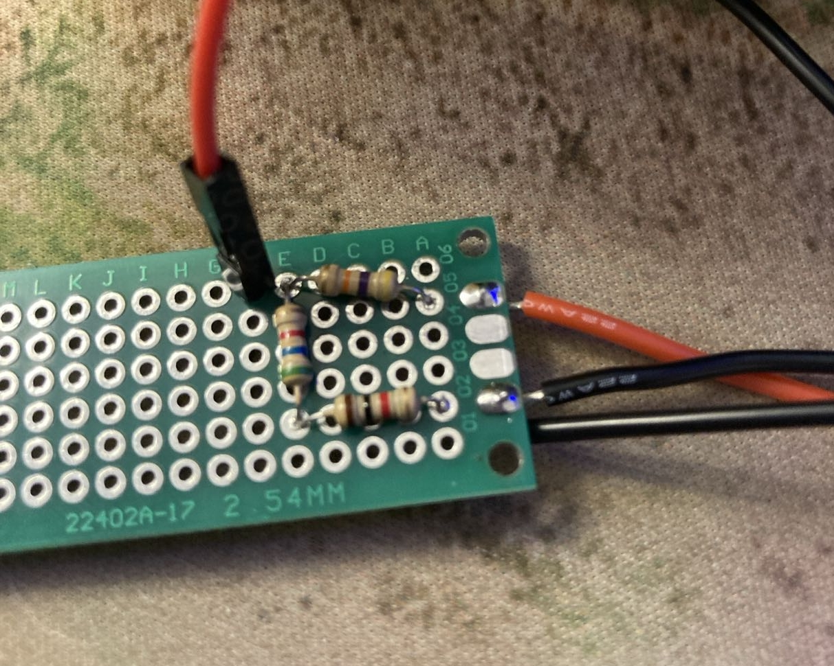
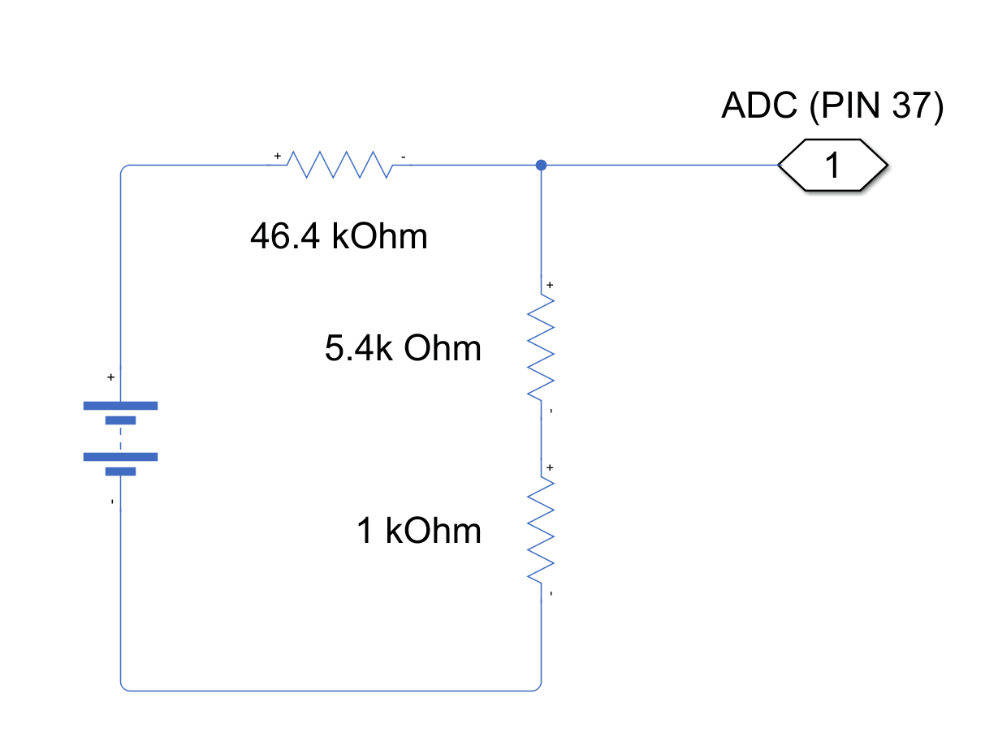
Voltage Divider

Slide 5
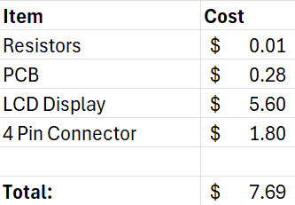
Materials Needed / Bill of Materials
Resistors: R1 = 46.4K ohm, R2 = 5.4K ohm, R3 = 1K ohm
PCB
LCD Display
Jumper Wires
4 Pin adapter for battery

Slide 6
Testing Method
Hardware Check
Apply known voltages
Verify voltage divider output with multimeter
ADC Validation
Input known voltage
Compare ADC reading to the expected value
Software Scaling
Convert ADC → battery voltage
Verify against multimeter reading
Display Test
Confirm correct voltage shown on LCD
Check formatting and stability

Slide 7
Questions?

